Slide 1


CHAPTER – RESTORING DELETED FILES AND SYSTEM
20CSP-155

Slide 2


WHAT WE WILL COVER ?
In this chapter we will go through various techniques that helps in restoring the deleted files from the computer and the computer system itself.

Slide 3

What is restoring ?
While working on the computer system we deal with number of files for making data inputs and the data which is required, is saved and rest will be deleted.
Sometimes, we require data that could possibly be deleted on later stage, so? What to do? How to recover it if we have deleted it, can we recover it? Yes of course, the deleted data can be recovered in number of ways let’s go through them in detail.

Slide 4

DATA RESTORE FROM RECYCLE BIN
Open the recycle bin icon from the desktop.
Choose View → Details
After getting into the Recycle bin you will see some columns such as name, date, location, size etcetera.
The Search command in Windows, the one you would normally use to locate lost files, doesn’t look in the Recycle Bin.
To recover a deleted file, click it and choose File➪Restore from the menu.

Slide 5
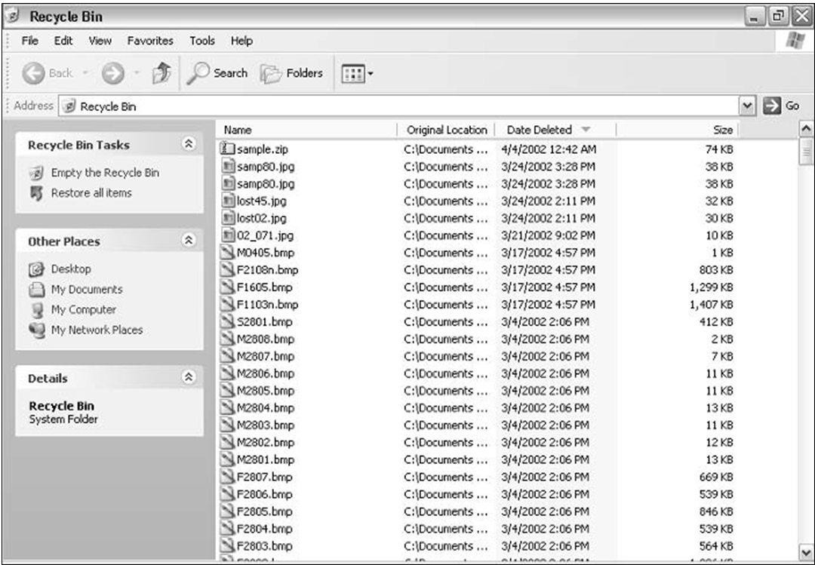
4. To recover more than one file, press the Ctrl key and hold it down as you click the files you want to restore.
5. You must restore a file to its original location, the folder from which it was deleted. If you need to move the file to a better location, do so after restoring it.
6. You cannot restore files that were deleted using the Shift+Delete key- stroke. Those files cannot be recovered by using any of the tools in Windows.

Slide 6
RESTORING RECENTLY DELETED FILE
To find a file that you suspect was just deleted, click the Date Deleted heading in the Recycle Bin window.
When the triangle next to Date Deleted points down, the most recently deleted files appear at the top of the list.
Scroll to the top of the list and pluck out the files you want recovered.

Slide 7

RESTORING A FILE WHEN YOU KNOW NAME
To locate a file by name, click the Name heading in the Recycle Bin window.
That sorts the files alphabetically by name, either from A to Z or from Z to A, depending on how many times you click the Name heading.
To quickly scroll to a given filename, type its first letter on the keyboard. To find all files beginning with N, for example, press the N key.

Slide 8

RESTORING A FILE CREATED FROM AN APPLICATION
Searching for files by type allows you to locate a file when you don’t know its name but you do remember which program created it.
That click the Type heading in the Recycle Bin window to sort the files by their file type (or by which program created them).

Slide 9

SYSTEM RESTORE
The System Restore utility in Windows is an excellent way to recover from just about any mishap, but specifically it works best for those it-was-working- yesterday situations.
With System Restore, you can turn back the clock on your entire computer system — yes, back to the good old days when things were working normally.

Slide 10

SYSTEM RESTORE POINTS
The System Restore utility lets you take your computer back in time only by setting various restore points.
Windows sets them automatically as you use your computer. More importantly, you should set them yourself before you make any extensive changes to the system.
For example, set a restore point before you add or upgrade any hardware or software. Set a restore point before you mess with any Windows settings — graphics, sounds, or wallpaper.

Slide 11
SETTING A RESTORE POINT
1. From the Start menu, choose Programs➪Accessories➪System Tools ➪ System Restore.
If System Restore doesn’t start up, it’s either disabled or you have another problem with your computer.
2. Choose the option labeled Create a Restore Point.
3. Click the Next button.
4. Enter a restore point description.
5. Click the Create button.
The new restore point is created, and the current day, date, and time appear on the screen. Nifty.
6. Click the Close button.
You’re done. System Restore closes its window and sneaks off.
The restore point description appears when you later use System Restore. Therefore, it helps to be descriptive here.

Slide 12
RESTORING A SYSTEM
1. Close any open windows or programs, to safely save any unsaved information.
2. Start System Restore.
From the Start menu, choose Programs➪Accessories➪System Tools➪ System Restore.
3. Choose the option labeled Restore My Computer to an Earlier Time.
4. Click the Next button.
5. Pick the date you want to take the computer back to.

Slide 13
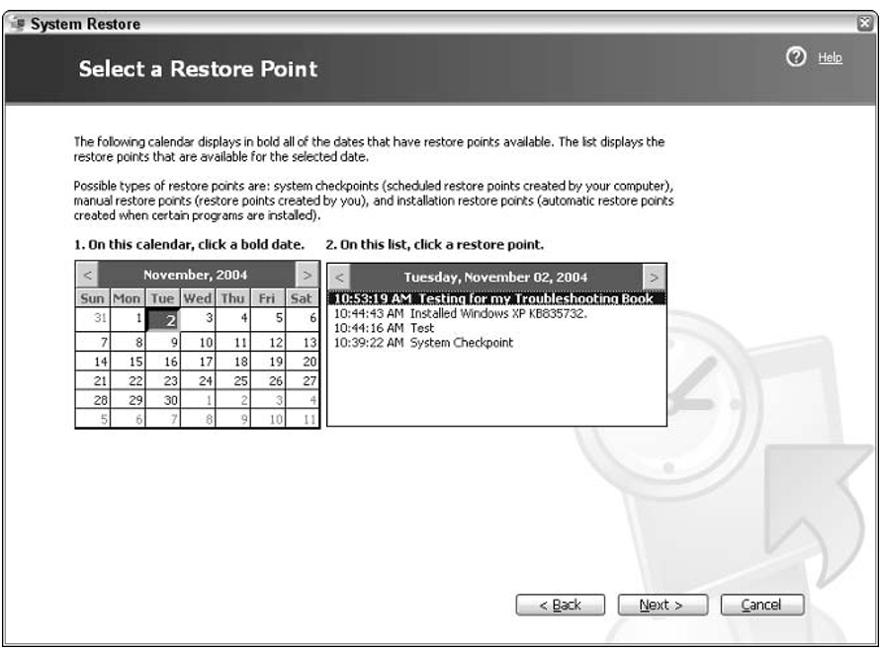
If you have set a specific restore point, choose the date where you set that restore point.
If more than one restore point is set on a date, as shown in Figure , choose it from the list.
6. Click the Next button.
Read the scary warning. The bottom line is that the System Restore process is fully reversible, so if System Restore makes things worse, you can undo its changes.
7. Click the Next button.
Windows restores, restarts, and. . . .
a screen eventually appears and tells you “Restoration Complete,”
8. Click ok

Slide 14
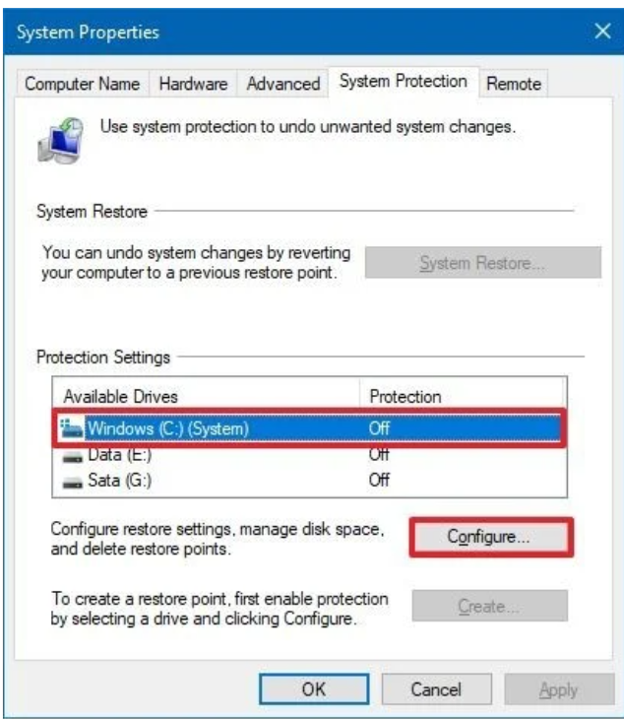
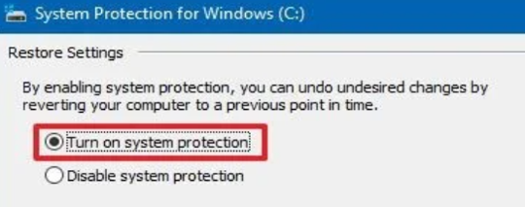
WINDOW 10 SYSTEM RESTORE
To enable System Restore, use these steps:
Open Start.
Search for Create a restore point and click the top result to open the System Properties page.
Under the "Protection Settings" section, select the main "System" drive
Click the Configure button.
Turn on system protection option.
Click apply and then ok

Slide 15
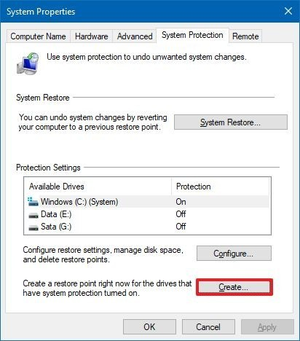
WINDOW 10 SYSTEM RESTORE POINT
To create a restore point on Windows 10 manually, use these steps:
Open Start.
Search for Create a restore point, and click the top result to open the System Properties page.
Under the "Protection Settings" section, click the Create button.

Slide 16
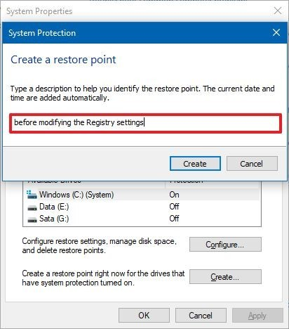
WINDOW 10 SYSTEM RESTORE POINT
4. Type a descriptive name for the restore point — for example, before modifying the Registry settings.
5. Click the Create button.
6. Click the Close button.
7. Click the OK button.
8. Click the Close button.
After you complete the steps, you'll have a way to undo changes in the event that something goes wrong while installing a new device driver, app, or after modifying the Registry.

Slide 17
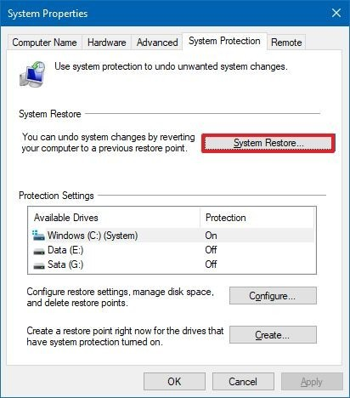
RECOVER USING SYSTEM RESTORE ON WINDOW 10
Open Start.
Search for Create a restore point, and click the top result to open the System Properties page.
3. Click the System Restore button.
Quick note: If the option is grayed out, then it means that the system does not have any restore point available.
4. Click the Next button.

Slide 18
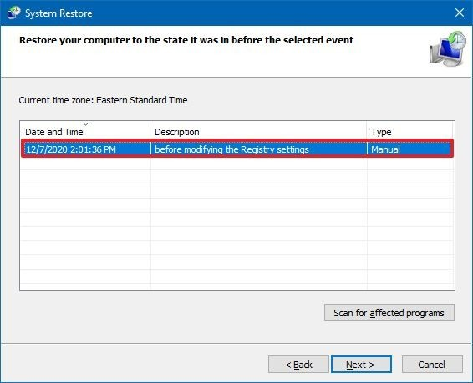
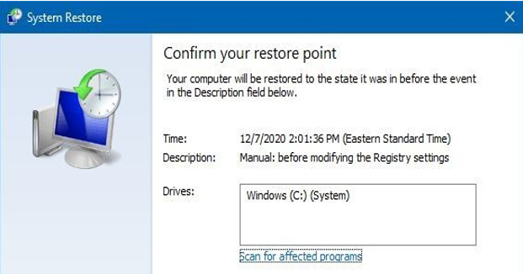
RECOVER USING SYSTEM RESTORE ON WINDOW 10
Select the restore point to revert changes.
Click the Scan for affected programs button to confirm the apps that will be removed because they were added after creating the restore point.
Click the Close button.
Click the Next button.
Click the Finish button.
Once you complete the steps, System Restore will return the device to the previous good working state.

Slide 19


BOOKS YOU CAN FOLLOW…
Build Your Own PC Do-It-Yourself For Dummies - Mark L. Chambers
Windows 10 Made Easy: Take Control of Your PC
Book by - James Bernstein
Laptops For Dummies
Book by - Dan Gookin
Troubleshooting And Maintaining Your PC All-in-One Desk Reference for Dummies
Book by - Dan Gookin

Slide 20
Prepared By : Samiksha Sharma Assistant Professor(CSE)
THANK YOU !

